Slide 1


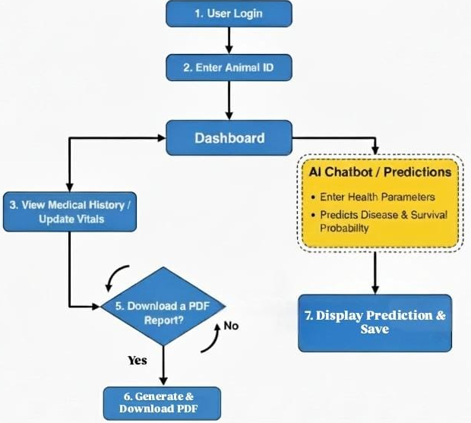
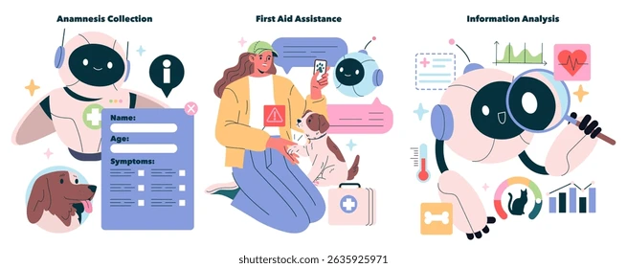
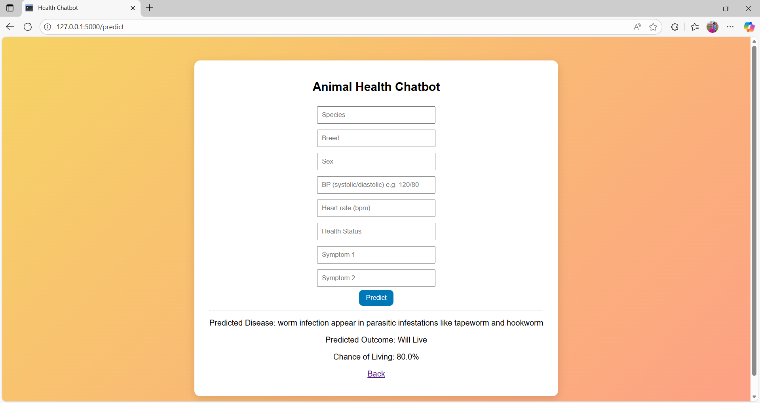
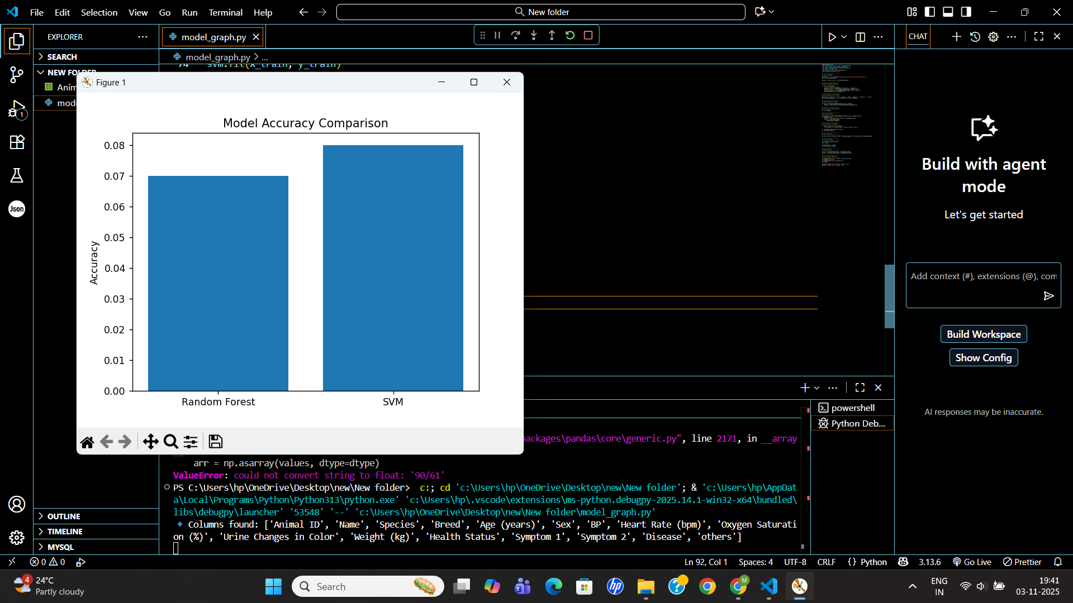
1 Department of Electronics and Communication Engine
{ chaya.bm,venkatesha.m, ananyan.13ec,deanrnd}@saividya.ac.in
SAI VIDYA INSTITUTE OF TECHNOLOGY
Niharika M Kodige, Mahima K, Ranjana H, SM Parkavi Under the guidance of Dr Varun E, Associate Professor, Dept., of CSE.
Department of CS&E, Sai Vidya Institute of Technology, Bangalore
TECHSPARDHA - PROJECT EXHIBITION-2K25
YUKTI Innovation ID:IR2025-1004527
INTRODUCTION
PROPOSED METHOD/STRUCTURE/BLOCK DIAGRAM
3. The assistant recommends required & provides timely alerts and reminders. It organizes all health-related data professionally, improving workflow & overall veterinary management.
4. This ensures doctors always have accurate, up-to-date information at the moment of consultation.
Rapid advancements in AI are transforming veterinary medicine, improving animal healthcare through smarter decision-making.
Traditional veterinary management faces challenges in real-time data handling, patient monitoring, and personalized interventions.
The project leverages AI to support clinical decisions, manage health records, and provide proactive care for livestock and pets.
COMPARISON WITH EXISTING METHODS
Table 1: Comparison Table
Methods | Parameter-1 | Parameter-2
Method-1 [Ref1] | ML Based disease classification | Limited to specific disease patterns
Method-2 [Ref2] | GPT-4o LLM | Generic LLM approach
Method-3 [Ref3] | AWS Cloud 3-tier Architecture | Scalable Infrastructure
Proposed Method | Integrated AI-Driven Web Application | Real Time Chatbot
Figure 2: Methodology
1. Data Collection: Centralized database for animal health records, including symptoms, vaccinations, vital signs.
2. AI Modeling: Machine learning algorithms(RF) process symptoms to predict health risks and suggest care or diagnosis paths.
3. User Interface: Web application for data input (animal ID, symptoms, vitals), viewing health history, and updating records.
Figure 1: Smart AI-Driven Animal Care
CONCLUSION
RESEARCH GAP
Existing solutions often address isolated aspects such as imaging or simple record-keeping.
Limited support for end-to-end decision-making in veterinary practice, particularly for multi-species, rural, and resource-limited contexts.
A need for integrated platforms combining health record management, AI-based symptom analysis, and actionable recommendations.
The AI-driven decision support system significantly advances veterinary management by unifying records, analysis, and recommendations in one platform.
Addresses critical research and operational gaps, supporting more proactive, precise, and efficient animal healthcare.
Paves the way for smarter, scalable, and personalized veterinary services especially useful in rural and resource-constrained settings.
RESULTS AND DISCUSSIONS
OBJECTIVES
1. Digitize and centralize animal health records for easy access and update.
2. Integrate AI to analyze symptoms and suggest possible diagnoses or actions. Provide veterinarians with visualization tools, alerts, and intelligent recommendations.
3. Enable features like vaccination tracking, health status prediction, mark for special care and automated PDF reporting.
PAPER PUBLICATION DETAILS
CONFERENCE NAME:
The project has resulted in a draft patent application that is currently under the process of preparation and approval. The patent details have been discussed and reviewed with our project guide, and the application is being finalized for official submission to the Patent Office.
Figure 3: AI-Chatbot predicting the disease
1. Using The AI-Chatbot trained on 200+ clinical cases analyzes symptoms to give precise disease predictions with confidence levels.
2. It helps veterinarians quickly assess possible conditions and supports faster diagnostic decisions.
REFERENCES
[1] Prashanna J and Dr. Vanita Jaitly, “AI-Powered Veterinary Chatbot for Automated Diagnosis,” Proceedings of the International Conference on Inventive Computation Technologies (ICICT), pp. 1629–1635, Jan. 2025.
[2] Y.-G. Jin, G. Wu, J.-W. Seo, S.-J. Park, S.-H. Hur, D. Aliyeva, J.-H. Park, and K.-M. Kim, “AI Veterinary Assistance: Enhancing Clinical Decision-Making in Animal Healthcare,” IEEE Access, vol. 13, pp. 119292–119299, July 2025.
[3] Dr. Deepika Soni, Dr. Awanit Kumar, Dr. Vikas Somani, and Dr. Sheshang Degadwala, “Veterinary Medical Records Application using AWS,” 5th International Conference on Mobile Computing and Sustainable Informatics (ICMCSI), pp. 578–583, Feb. 2024.
METHODOLOGY
The system is designed for veterinary doctors as primary users, supported by an AI assistant that helps during diagnosis. A structured setup maintains animal details and health histories, with modules for doctor login, unique animal IDs with QR codes, and complete health records. Rule-based AI suggests likely diseases and sends real-time notifications about doctor availability, clinic updates, vaccination reminders, and other important alerts.
Figure 4: accuracy of finding exact disease

